Slide 1
CSE326 Internet Programming Laboratory Lecture #4
Dr. Navneet Kaur

Slide 2
Outline
Introduction to Cascading Stylesheets (CSS)
CSS syntax
Types of CSS
Comments in CSS

Slide 3
Introduction to CSS
CSS was designed to enable the separation of presentation and content.
CSS was introduced in 1996 by the World Wide Web Consortium (W3C), which also maintains its standard.
CSS is a language for specifying how documents are presented to users — how they are styled, laid out, etc.
These allows you to create great-looking web pages. CSS can be used for very basic document text styling — for example, for changing the color and size of headings and links.

Slide 4
Introduction to CSS
It can even be used for effects such as animation.

Slide 5
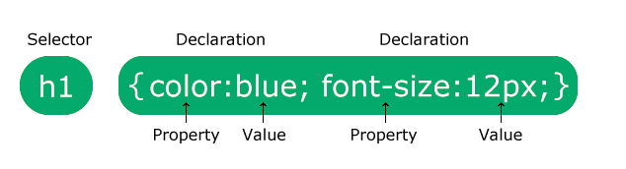
CSS syntax
CSS is a rule-based language — you define the rules by specifying groups of styles that should be applied to particular elements or groups of elements on your web page.
For example, you can decide to have the main heading on your page to be shown as a blue text. The following code shows a very simple CSS rule that would achieve the styling :
h1 {
color: blue;
font-size: 12px;
}

Slide 6
Types of CSS
Inline
Internel/Embedded
External

Slide 7
Inline stylesheet
Inline styles are CSS declarations that affect a single HTML element, contained within a style attribute.
<h1 style="color: blue; font-size:12px;">
Hello World!
</h1>

Slide 8
Internel/Embedded
An internal stylesheet resides within an HTML document.
To create an internal stylesheet, you place CSS inside a <style> element contained inside the HTML <head>
<head>
<style>
h1 {
color: blue;
font-size:12px;
}
</style>
</head>

Slide 9
External stylesheet
An external stylesheet contains CSS in a separate file with a .css extension.
You can link a single CSS file to multiple web pages, styling all of them with the same CSS stylesheet.
HTML file: (Lecture4.html)
<head>
<link rel="stylesheet" href="styles.css" />
</head>
<body>
<h1>Hello World!</h1>
</body>

Slide 10
External stylesheet
style.css
h1 {
color: blue;
font-size:12px;
}

Slide 11
Comments in CSS
A CSS comment is used to add explanatory notes to the code or to prevent the browser from interpreting specific parts of the style sheet.
By design, comments have no effect on the layout of a document.
/* */

Slide 12
References
https://www.w3schools.com/css/css_syntax.asp
https://www.w3schools.com/css/css_intro.asp
https://www.w3schools.com/html/html_css.asp
https://www.w3schools.com/css/css_text.asp
https://www.w3schools.com/css/css_text_align.asp
https://www.w3schools.com/css/css_dimension.asp
https://www.w3schools.com/css/css_margin.asp

Slide 13
Program link
https://onlinegdb.com/xySGp3m09
https://codepen.io/Dr-Navneet-Kaur/pen/qBLaZWN

Slide 14
Week 4 assignment
Go to → https://www.freecodecamp.org/learn/2022/responsive-web-design/
Complete steps 8 to 25 of “Learn Basic CSS by building a Cafe Menu”

Slide 15
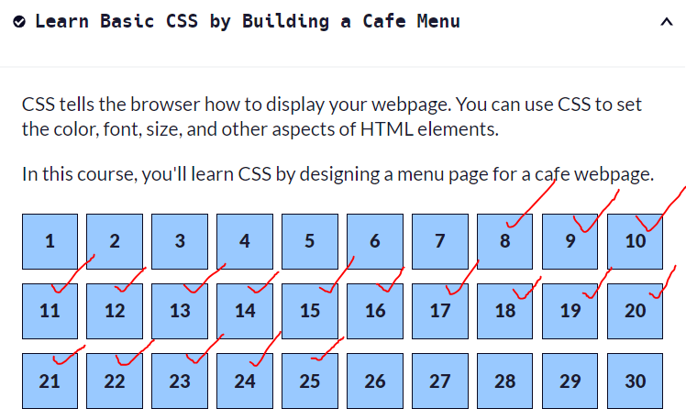
Week 4 assignment

Slide 16
Thank you

